Slide 1

datum lexer design

Slide 2
K. S. Ananth
Nimai Parsa
M. Bhavesh Chowdary
Arugonda Srikar
G. S. S. Koushik
M. Kartikeya
Mohammed Gufran Ali
TEAM MEMBERS

Slide 3
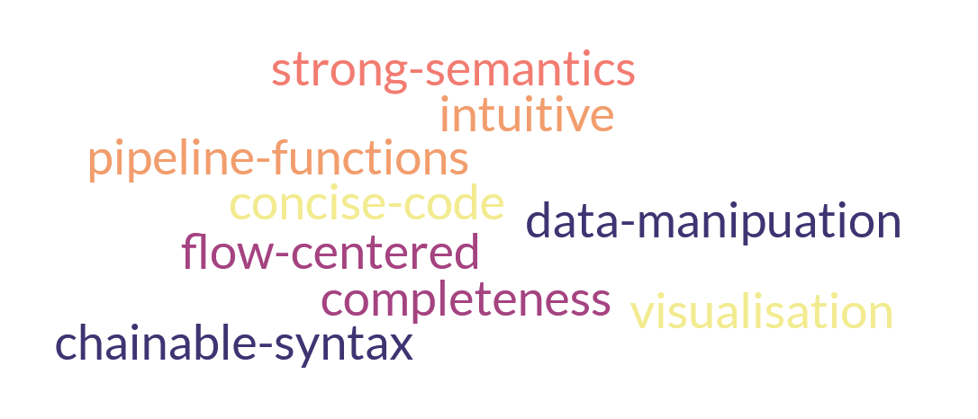
Small intro to datum

Slide 4
Small intro to datum
In lexical phase, we extracts tokens from the input program. We pass these tokens for next phase
We wrote the rules in .l file and generated lexical analyzer (executable) using flex tool.
The whitespaces and comments gets ignored.
Open comments, illegal characters gets detects as errors and prints it to console.

Slide 5
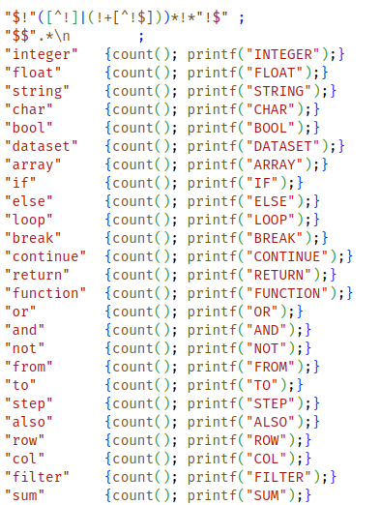
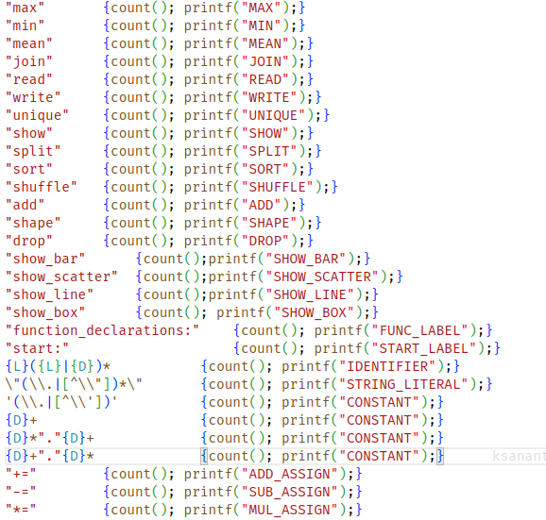
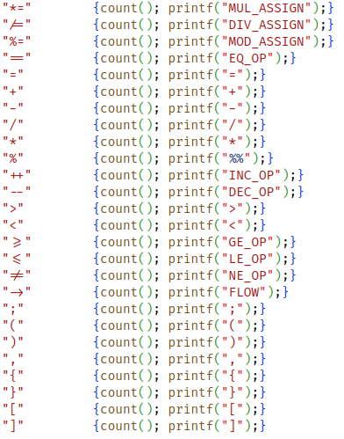
CODE SNIPPET

Slide 6
Sample code
SAMPLE output
FUNC_LABEL
FUNCTION ( DATASET IDENTIFIER ) FLOW IDENTIFIER ( ) FLOW DATASET {
ARRAY ( IDENTIFIER ) IDENTIFIER = IDENTIFIER FLOW MEAN ( CONSTANT ) ;
LOOP IDENTIFIER FROM CONSTANT TO IDENTIFIER FLOW SHAPE [ CONSTANT ] {
IDENTIFIER FLOW COL ( IDENTIFIER ) SUB_ASSIGN IDENTIFIER [ IDENTIFIER ] ;
}
ARRAY ( IDENTIFIER ) IDENTIFIER = IDENTIFIER * IDENTIFIER FLOW SUM ( CONSTANT ) / IDENTIFIER FLOW SHAPE [ CONSTANT ] ;
LOOP IDENTIFIER FROM CONSTANT TO IDENTIFIER FLOW SHAPE [ CONSTANT ] {
IDENTIFIER FLOW COL ( IDENTIFIER ) DIV_ASSIGN IDENTIFIER [ IDENTIFIER ] ;
}
RETURN IDENTIFIER ;
}
START_LABEL
DATASET IDENTIFIER = READ ( STRING_LITERAL , STRING_LITERAL )
IDENTIFIER FLOW COL ( CONSTANT )
FLOW IDENTIFIER ( CONSTANT )
FLOW ROW ( {
RETURN IDENTIFIER [ CONSTANT ] EQ_OP IDENTIFIER ;
} ) FLOW DROP ( CONSTANT ) ;
IDENTIFIER FLOW IDENTIFIER ( ) FLOW WRITE ( STRING_LITERAL , STRING_LITERAL ) ;
function_declarations:
function (dataset ds) -> normalize() -> dataset {
array(int) mean_arr = ds->mean(1);
loop i from 0 to ds->shape[0] {
ds->col(i) -= mean_arr[i];
}
array(int) std_arr = ds*ds->sum(1) / ds->shape[0];
loop i from 0 to ds->shape[0] {
ds->col(i) /= std_arr[i];
}
return ds;
}
start:
dataset ds = read("./dataset", "csv")
ds->col(1)
->fill_null_values(0)
->row({
return r[0] == null;
})->drop(0);
ds->normalize()->write("./dataset.csv", "csv");

Slide 7
DEMO FOR LEXER
https://drive.google.com/file/d/1GwMW1hHCxU5I6jFpPWGmZTH70Ek3j6te/view?usp=drive_link
CODE LINK
Datum/lexer/lexer.l at main · ksananth4424/Datum (github.com)
REFERENCES USED
ANSI C Lex: ANSI C grammar (Lex) (liu.se)

